Slide 1
Web Search Engine
Turf Booking Platform…….
Group members: -
Ratan Singh-( 9511 )
Aarush Wasnik-( 9517 )
Guided by :- Prof. Archana lopes

Slide 2
INTRODUCTION:-
A web search engine that will be specifically be used to booking a turf at best deals.
Some insight: -
Compares Various deals available on that turf.
Host Various turf websites.

Slide 3
PROBLEM STATEMENT
Users are not able to avail the best sorted deals according to their need and pocket size at one stop platform.
In this rapidly developing world, the area available for the outdoor activities has been reducing day by day. So, people prefers to book a play inside the turf. But the main problem faced by the sports enthusiast is that they don’t have enough resource or single website where they can browse and book their favourite and best offered deal to them without doing any manual work for longer duration of time. So we decided to build a search engine which will be specifically be used for sorting turf with their need.

Slide 4
Objective
To allow users to search and view information about Turf online using our search engine.
Using various filters (such as rating, amenities, price range) as keywords to find the most accurate search result.
Using a sorting algorithm with condition term frequency of filter keyword.

Slide 5
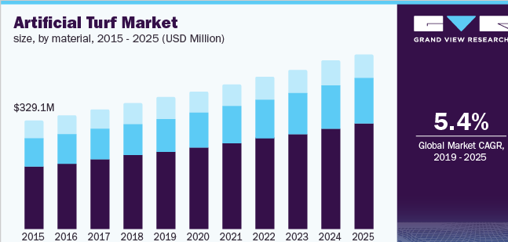
NEED FOR A SEARCH ENGINE
One stop platform where user can find the satisfactory output from the search engine.
Rising demand for the turf, but no application where user can compare the turf in term of space , price , ratings .
Global Artificial Turf Market 2021-2025:- The analyst has been Monitoring the artificial grass turf market and it is poised to grow by Rs 104 crore during 2021-25 progressing at the CAGR of over 5.45% during the forecast period.

Slide 6
Extensive LITERATURE SURVEY

